Slide 1
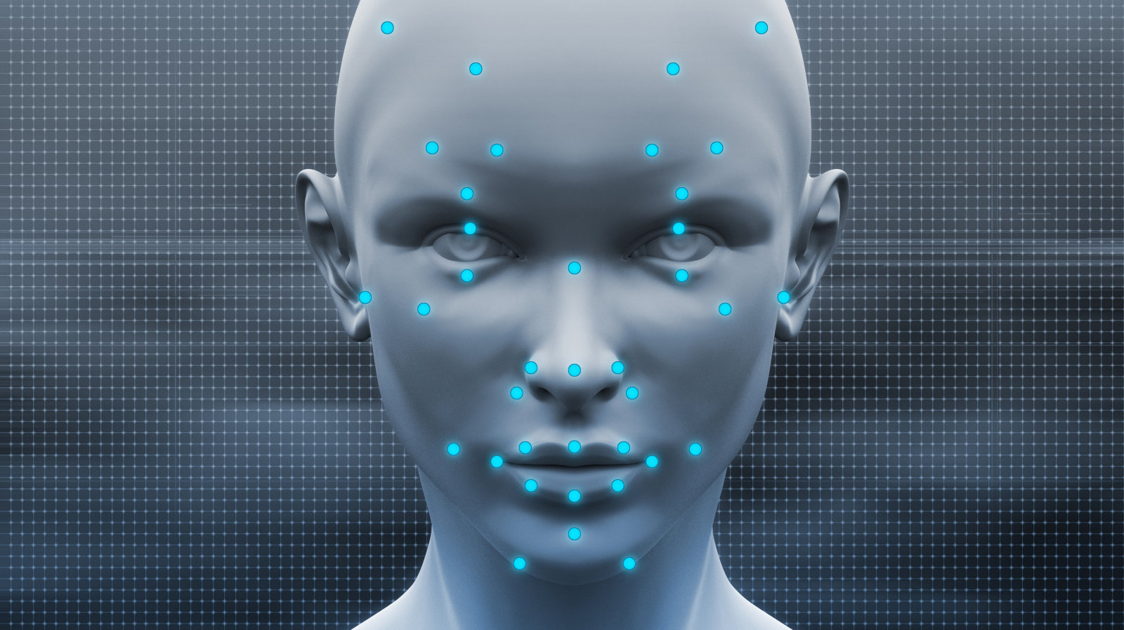
Disclaimer
In this project we explored and played with the pre built and pre trained models of Intel Movidius Neural Compute Stick using the repository – NCappZoo.

Slide 2
Intel Movidius Neural Compute Stick (NCS)
Project by:
Rithwik Chhugani
Gautam Sadarangani
Daksh Khandelwal
Pratiksha Sharma

Slide 3
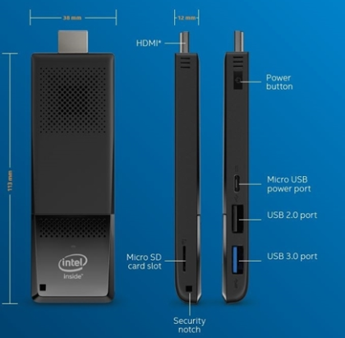
Compute Stick
Single-Board computer which has I/O, memory and micro - processing all built on a single circuit.
Compute Stick or computer on a stick can be thought of as a screenless PC.

Slide 4
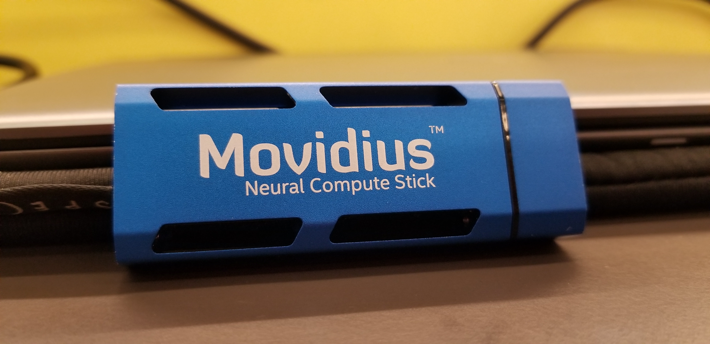
The ‘Intel Movidius Neural Compute Stick’ is a tiny, fanless deep learning USB drive designed to learn AI programming which is powered by ‘low-power-high-performance’ Intel Movidius Vision Processing Unit (VPU).
Intel Movidius NCS:
It is found in millions of Smart Security Cameras, Gesture-Controlled Drones, Industrial Machine Vision Equipments and many other devices.
It is an offline device that does not require connection to the cloud.

Slide 5
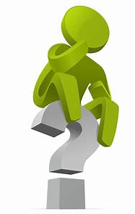
How does the Intel Movidius work?
The NCS device works by taking live image feed from the camera and then processes it using the inbuilt apps.
In the second stage it tries to take inferences from the pre-trained models or its dataset and gives the approximate corresponding outputs.

Slide 6
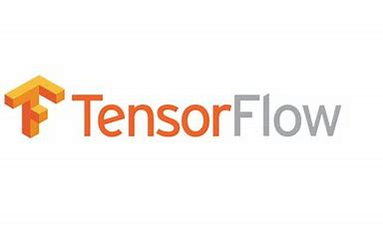

How to train the device?
The network is trained using TensorFlow or Caffe.
Train a network

Slide 7
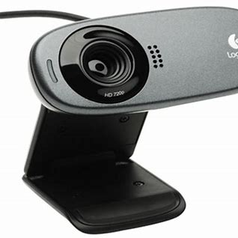
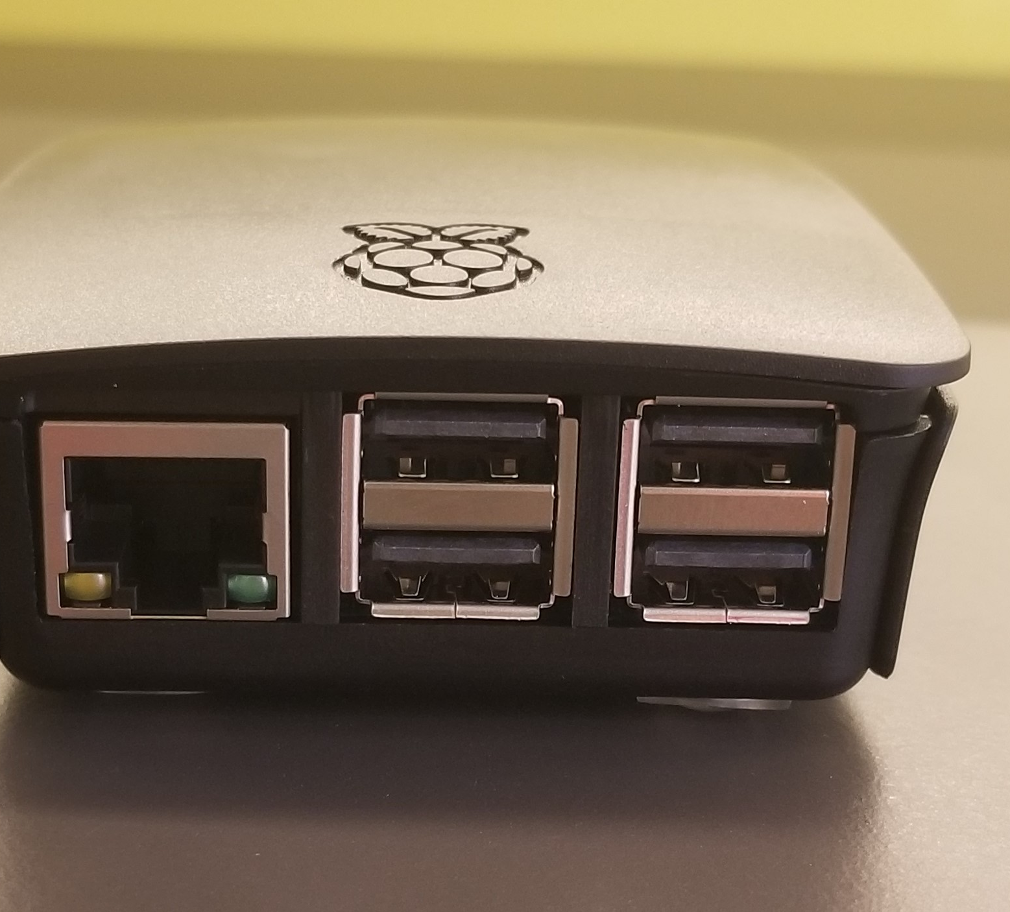
Requirements to run the ncs device:
NCS device
Any linux distribution or raspberry pi 3
A camera (webcam or a pi cam)
NCSDK (required to interact with the NCS device)
NCAppZoo

Slide 8
Getting started
Note: Whole process has been carried out on laptops running ubuntu linux 16.04 and above. If you would like to do it with Raspberry Pi then the link that can get you started is:
https://www.pyimagesearch.com/2018/02/12/getting-started-with-the-intel-movidius-neural-compute-stick/

Slide 9
What is NCSDK? (Neural Compute Software Development Kit)

Slide 10
What is NCAppZoo? (Neural Compute Application Zoo)
NCAppZoo is a repository of examples that demonstrates how the NCSDK and Movidius stick can be used to train and process neural network graphs more efficiently than typical CPUs.
This finally allows us to run some examples and get various outputs according the information stored in it’s database.

Slide 11

Image Classification Applications:
Image classification applications typically use one of the image classification networks in the repository to classify an image as to it's likeliness to be in each of the classes on which a network was trained.

Slide 12
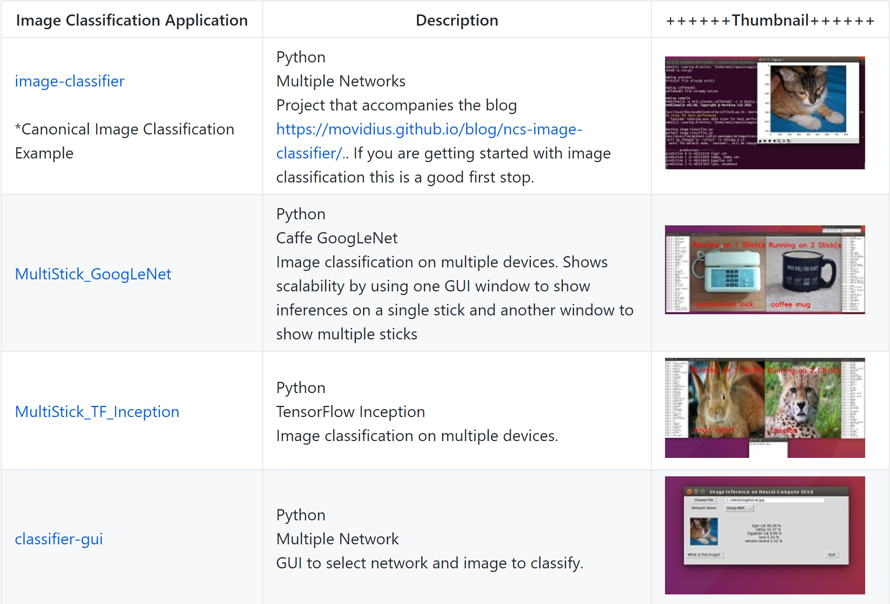

Slide 13
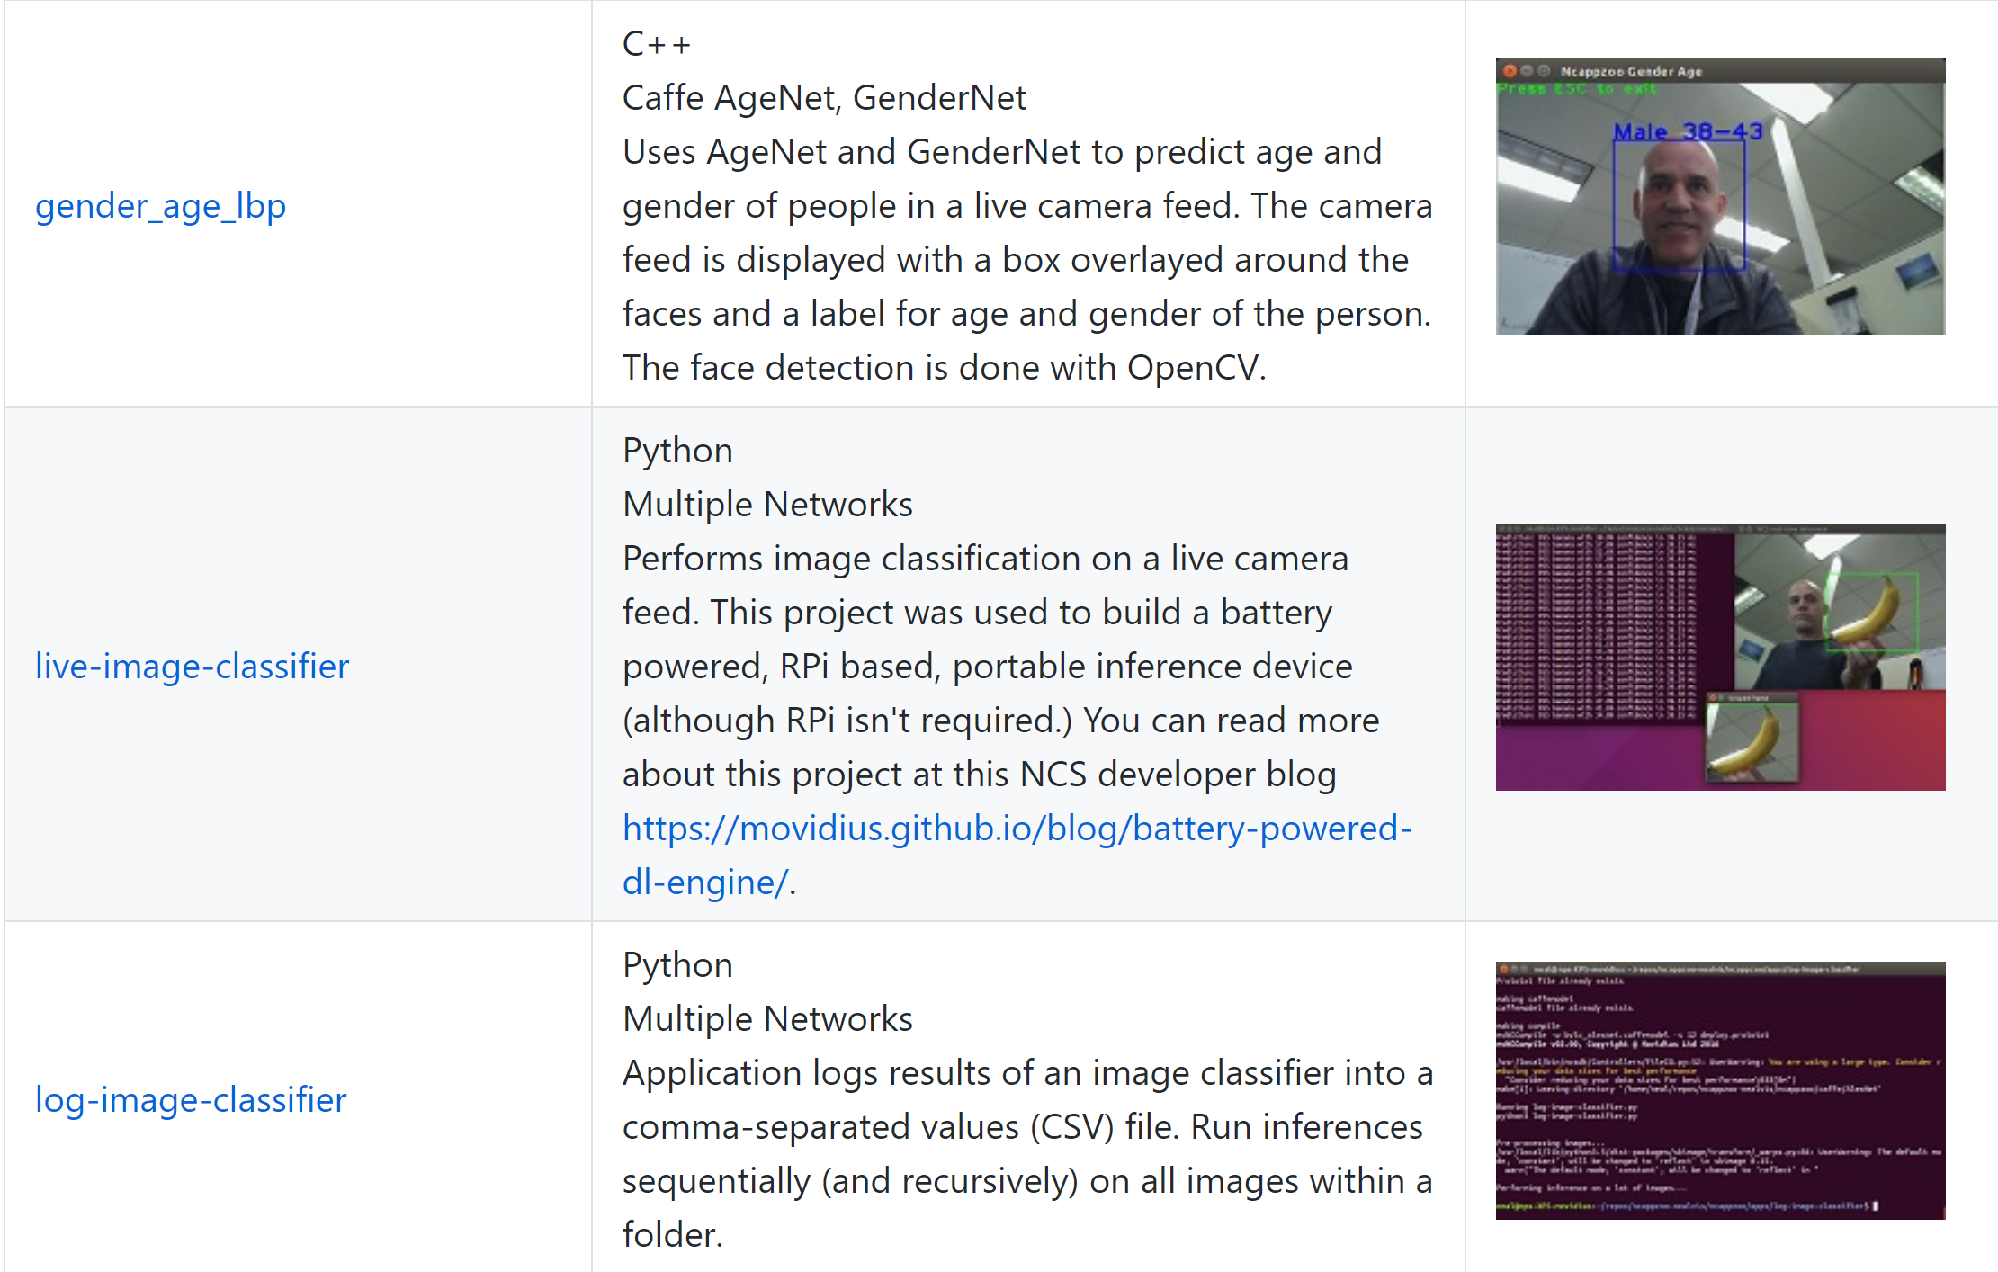

Slide 14
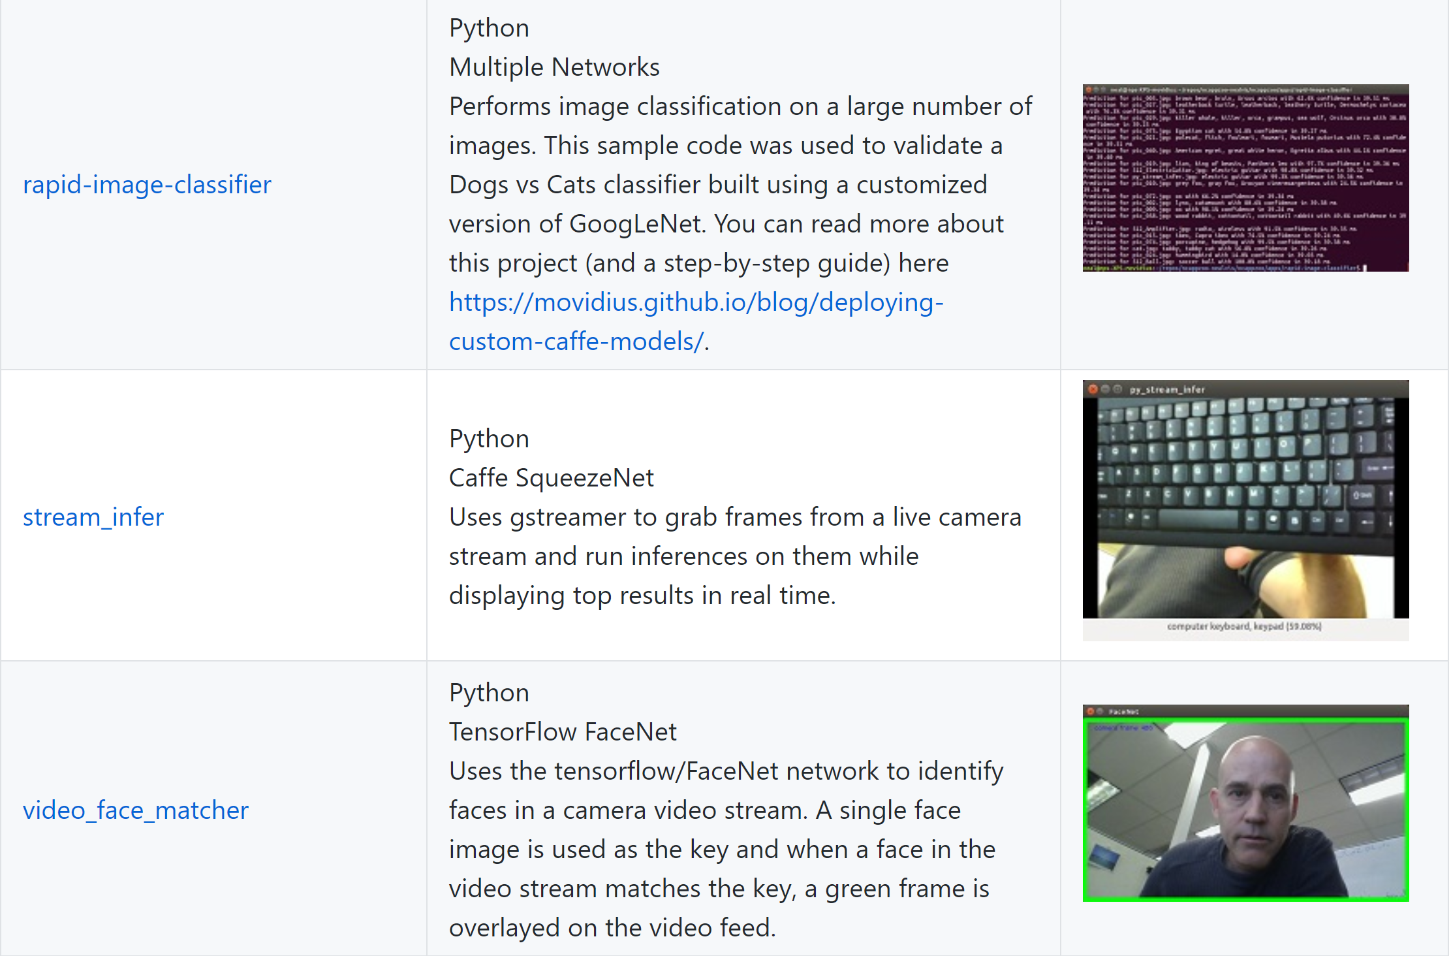

Slide 15
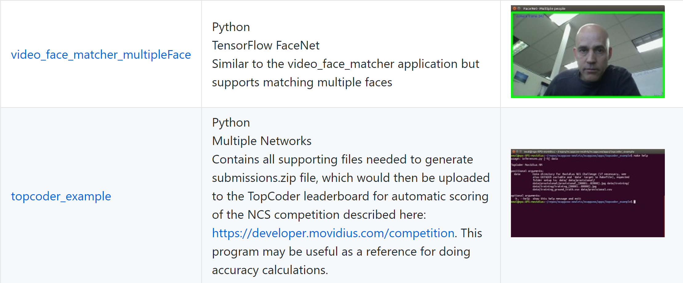

Slide 16
Object Detection Applications:
Object detection applications make use of one of the object detection networks in the repository to detect objects within an image. The object detection networks typically determine where objects are within the image as well as what type of objects they are.

Slide 17
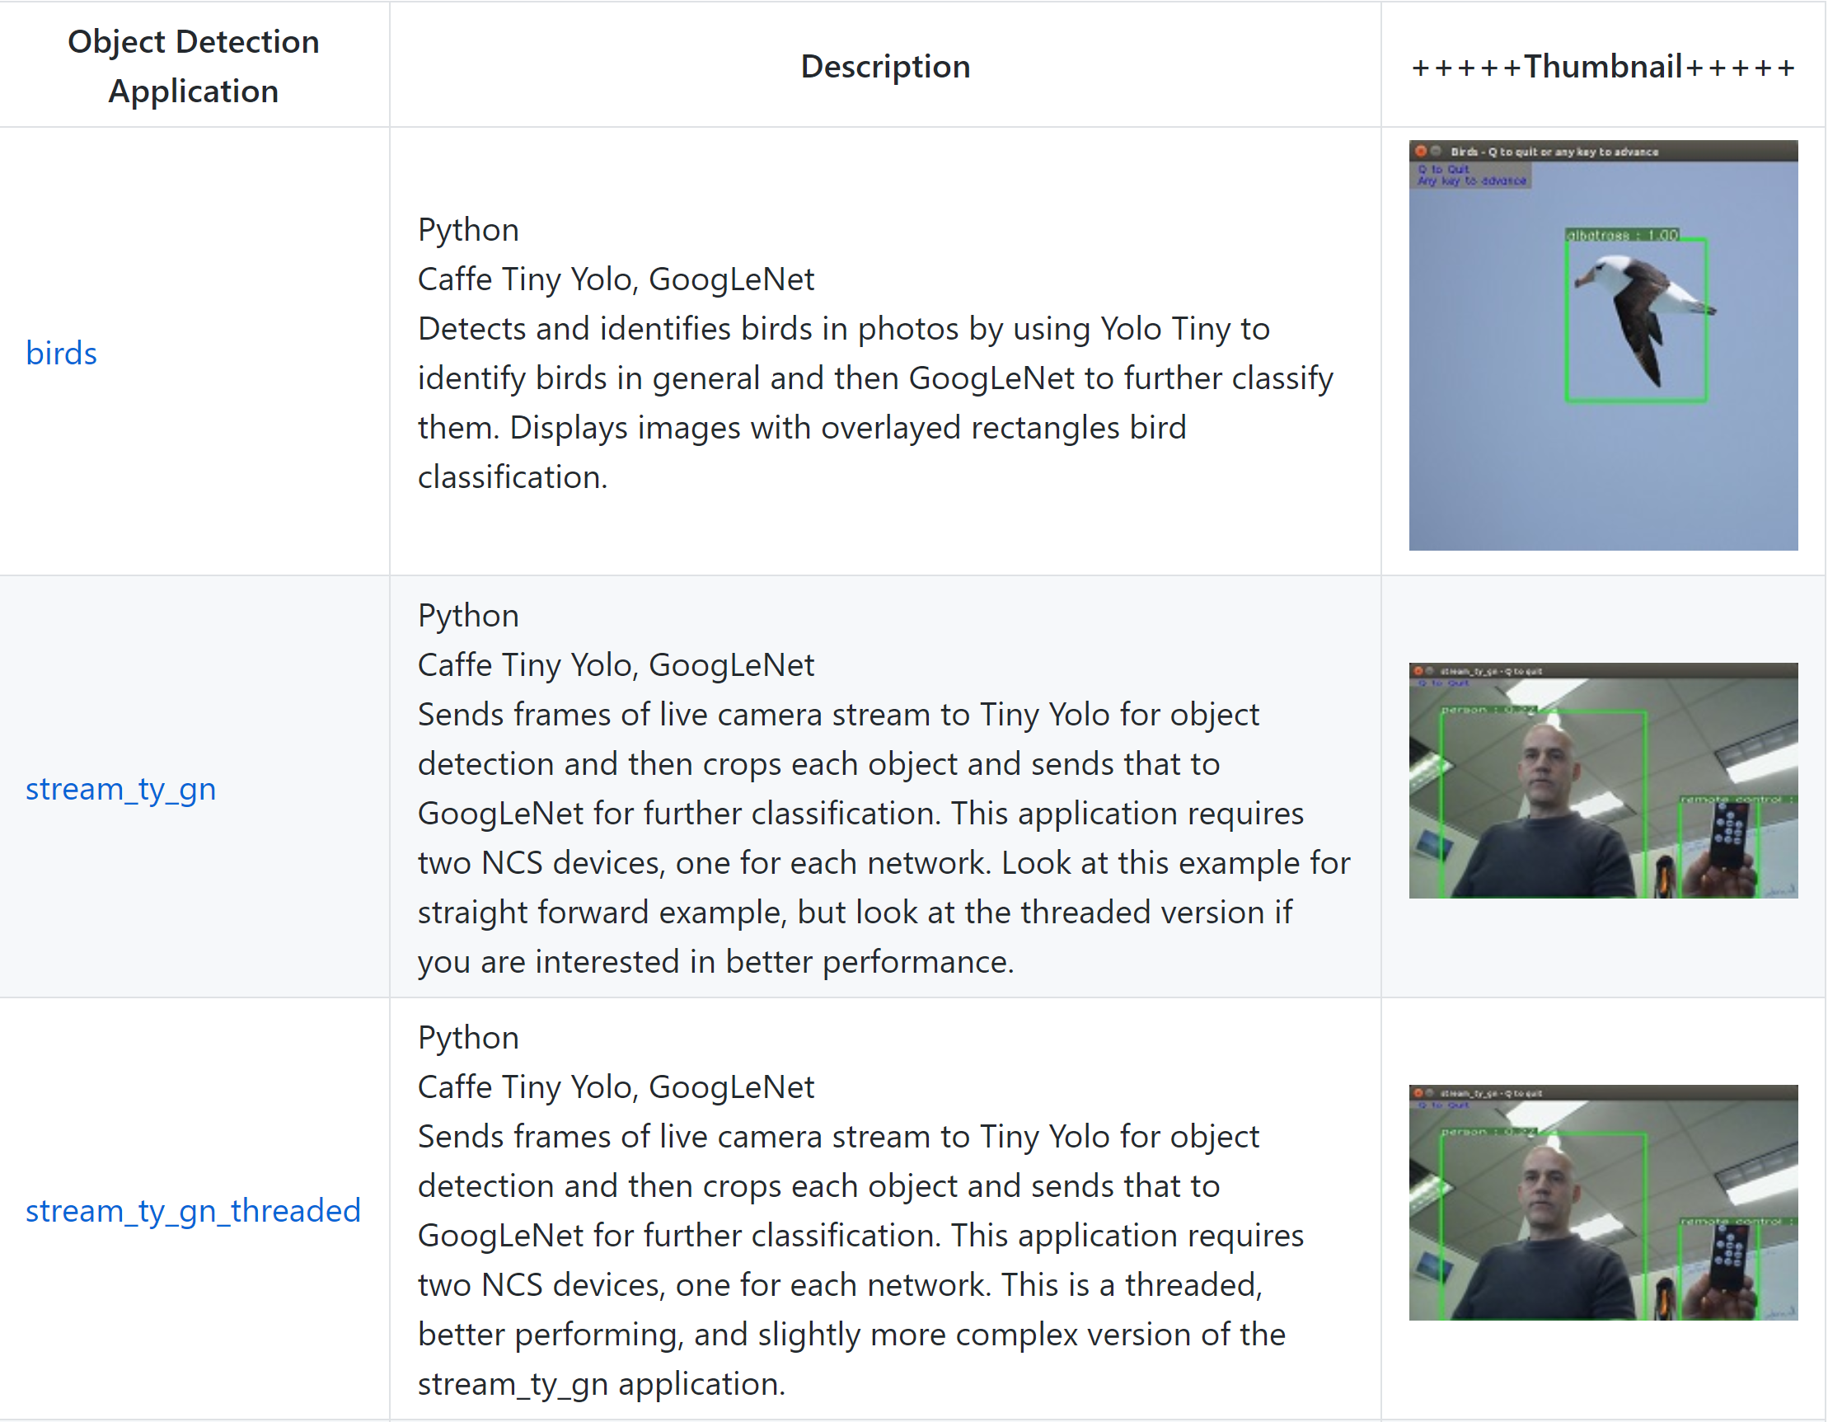

Slide 18
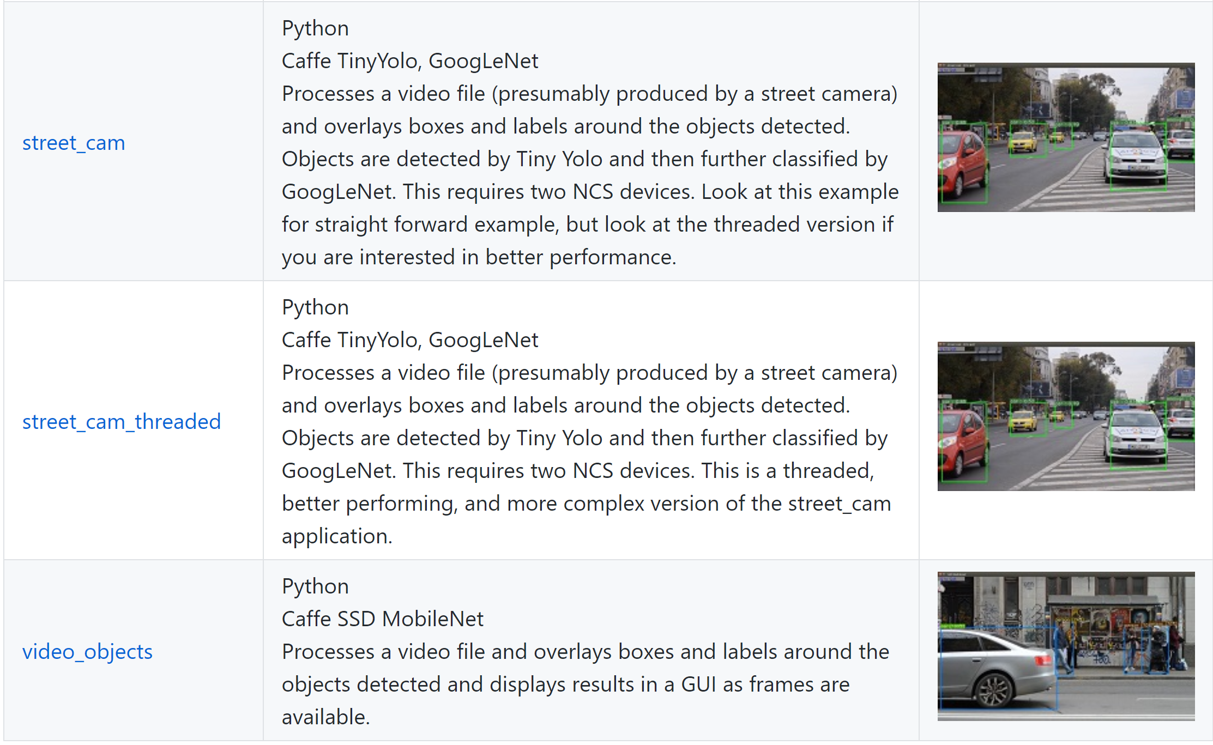

Slide 19
Misc Applications:
Miscellaneous applications use the NCSDK in various ways that don't fit into any of the above categories but can still be interesting.

Slide 20
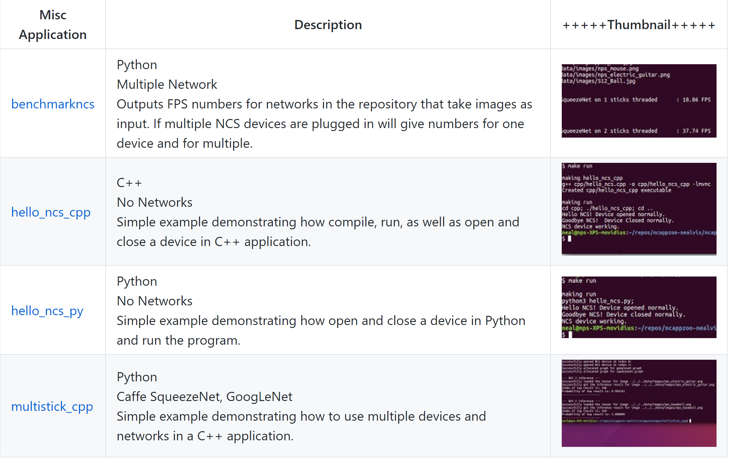

Slide 21

Application of this device in real-world
Considering a retail store, there are many things that skip human mind but may be essential when we think about boosting the sales of the store. A human maybe inefficient in keeping track of all the activities in the store and that is where we need such devices.

Slide 22
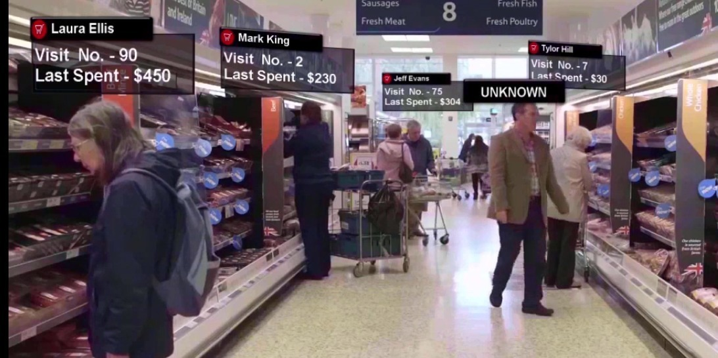
In a day there maybe, hundreds of people walking in and out of the store. Amongst them there are many who are frequent customers and like to buy some goods, making a database about such people we can render special discounts for them as they continue to have faith in the store and the staff.

Slide 23

Another activity happening in the store is maximum sold commodity in the store. If we know this then we can plug in some special offers with that so that other products that are not doing good with their sales, start getting at par with others.

Slide 24

At the time of billing the store often likes to collect personal details for their own records. Amongst all the questions asked people are a bit reluctant to disclose their age so this can be made possible by age classification that is a program in movidius.

Slide 25
Things that can help us make the database better are as follows:
Name
Age group
Gender
Frequency of customer
Frequently bought products
Preferred time frame to walk in
Average billing amount
With or without visitors

Slide 26


Adopting this system we can also get additional information regarding the visitor’s accompanying the customers. This will help us to build a larger database. Also increasing the possibility of attracting new customers by converting the visitors into potential customers.

Slide 27
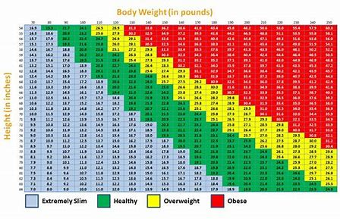
Other use of this device
BMI analysis of people

Slide 28
Following programs will be used to carry out all these things
Video face matcher
Gender age lbp
Live image classifier
Object detector
Rapid image classifier
Classifier gui

Slide 29
Thank you!!!

